Slide 1
Learning in
Product Management

Slide 2


Slide 3
Four steps
Set a baseline
Decide what to learn
Figure out how to learn it
Repeat

Slide 4
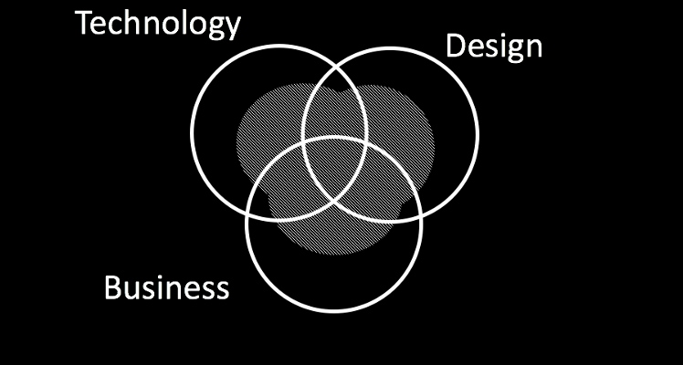
Step 1: Set an honest baseline

Slide 5
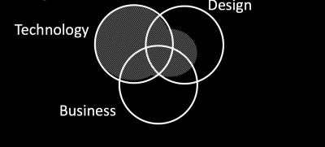
Engineer

Slide 6


Slide 7
Step 2: Decide what to learn next
Where do you struggle now?
What does the company need next?

Slide 8
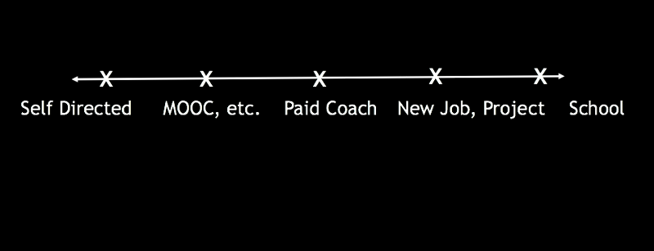
Step 3: Decide how to learn it

Slide 9
Step 3: Decide how to learn it
Is it strategic or tactical knowledge?
Is it close to what you already know?
Do you need credibility?

Slide 10
Step 4: Repeat

Slide 11
Summary
Set an honest baseline
Decide what you need to learn next
Figure out the best way to learn it
Repeat

Slide 12


